Slide 1
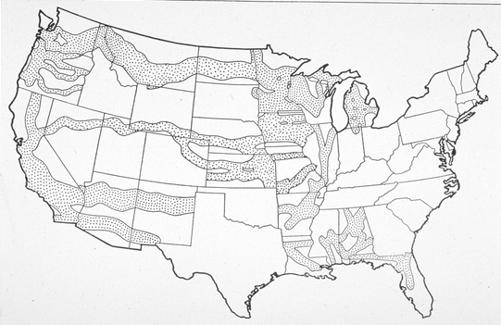
U.S. Western Railway Land Grants

